Slide 1

Swagger UI, Swagger Code Gen, Autorest
Joel Dickson
Development Manager at Agoda
NUnit Core Team Member

Slide 2

Overview
What is Swagger and Swagger UI
Swagger Code-Gen and Autorest
Different Languages and some gotchas
Building Client Libraries in TeamCity

Slide 3
What is swagger? Swagger UI?
http://swagger.io/
Swagger is a JSON representation for Your REST API (Think WSDL for REST)
Swagger UI is a UI that can run on top of this for documentation and testing
Swashbuckle is the .NET port of swagger (Swagger was originally a node js library)
Swagger Codgen is a Java based command line that will generate a client proxy library using the swagger json format, in 26 different languages http://swagger.io/swagger-codegen/
Autorest is a command line tool development by Microsoft to generate Client libraries for swagger, it supports 5 languages (C#, Node js, Ruby, Phython, Java) https://github.com/Azure/autorest

Slide 4
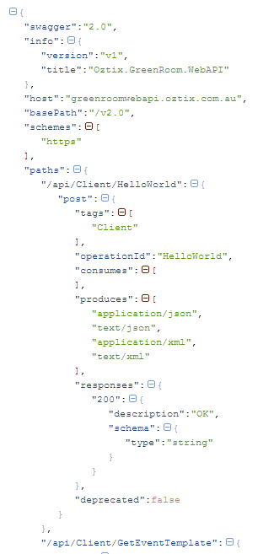
Swagger
Swagger will mount by default at /swagger/docs/v1 (you can change this)
Returns a large JSON output which defines all your methods
The swagger UI will mount at /swagger

Slide 5
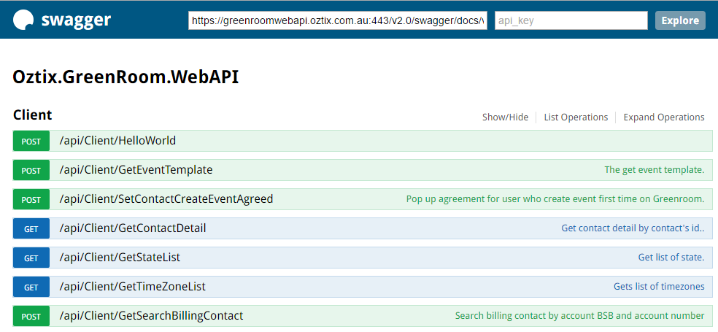
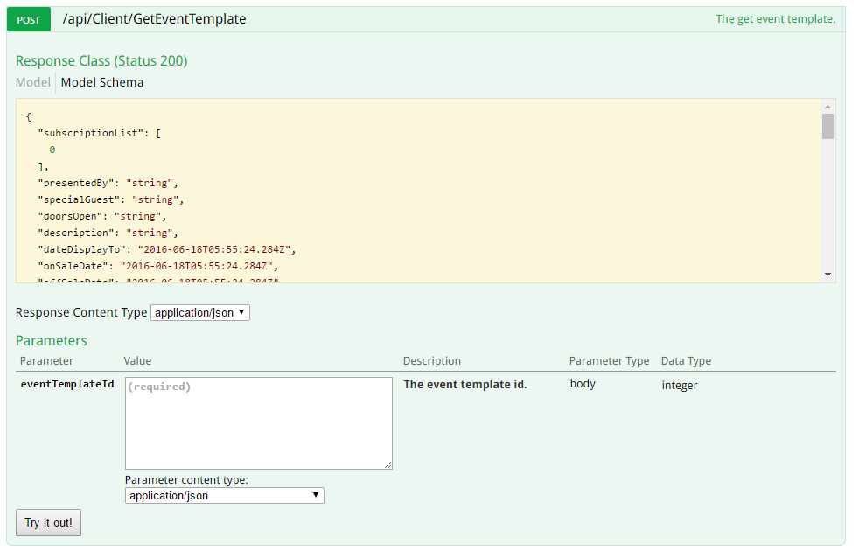
Swagger UI
Documents all methods with JSON representation of parameters and objects
Allows user to “Run” methods in the browser with dummy data

Slide 6
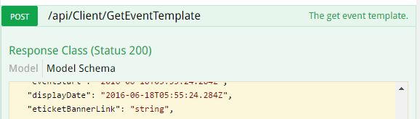
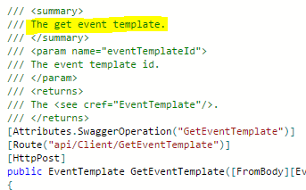
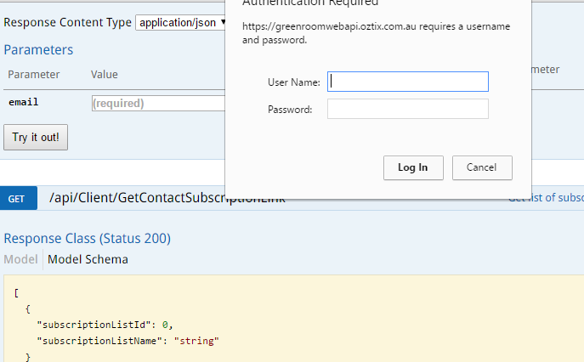
Swagger UI (cont)
Can get data from XML comments for documentation
Support for basic authenticaiton and OAuth
Example 2 (Swagger)

Slide 7
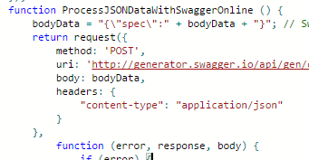
Swagger Code Gen
It works
Marven package available
Online API available http://generator.swagger.io/
Gotcha note: have to wrap the JSON format in “spec”

Slide 8

Autorest
Nuget package available
Much better for generating C# - uses the newer Microsoft.Rest.ClientRuntime library
Typescript generation is only supported in Node js, cant use it in web browser due to dependancies

Slide 9



Some Gotchas
Casing differences between languages
JSON is camel so doesn’t parse correctly but the Generated client library will take care of this
We found the Best Practice is:
Write Web API C# in Pascal casing
Covert using an action filter from pascal to camel case Json objects
Creating the client with TyepScript (or other camel language) default option will then work
The autogenerated C# client will add the JsonProperty to translate from camel to pascal and resulting C# client will be pascal cased like c# should bem, and your TS libs will be camel
C#
Typescript
C# Client Library

Slide 10
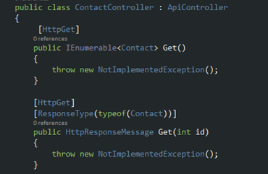
Gotcha’s (Cont.)
This post from MS is about the common errors with WebAPi project dealing with duplicate ID generated by swashbuckler
Issue is when you have a single Controller with more than one method on the same http action
In this example both methods are generate with the same ID
Solution is to create a Filter. Blog post about it here

Slide 11
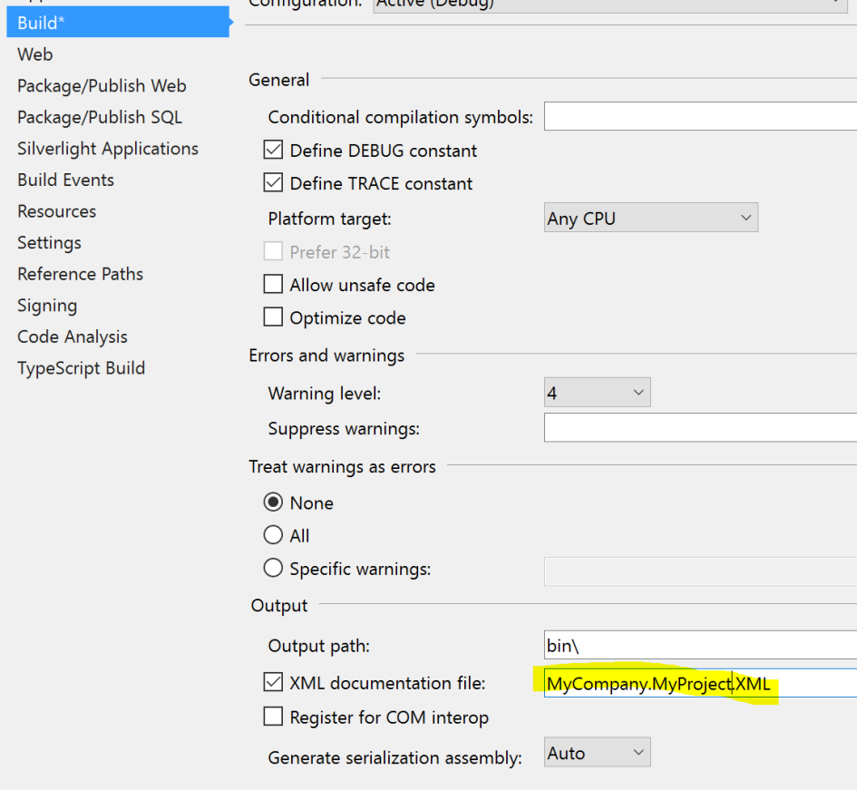
Use comments as Documentation
Swagger uses the xml document file that is outputted by the c# project
If you are releasing this public be careful
http://www.vidarholen.net/contents/wordcount/

Slide 12
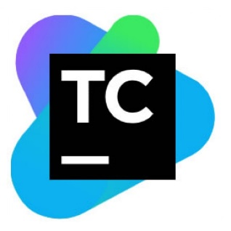
Build it, Pack it, Ship it
Full blog post on the subject available
Quick run through today

Slide 13
Challenges
To get the json object you have to run the code, so within your build process you need a web server to deploy to
We decide to deploy to a server using Octopus, you could also run a web server on the build agent itself or something of the like.
Steps
Build WebAPI project
Deploy Web API project to Dev server
Download json file from Dev Server
Build client

Slide 14
TeamCity Step 1 – Build/Deploy to dev web
Standard Build in TeamCity but we use octopus to publish the package to a web server.
We have added the autorest nuget package to our solution’s package.config, and also the packages that the client requires
Newtonsoft.Json
Microsoft.Rest.ClientRuntime
And added a nuspec file to be used for package the nuget package

Slide 15
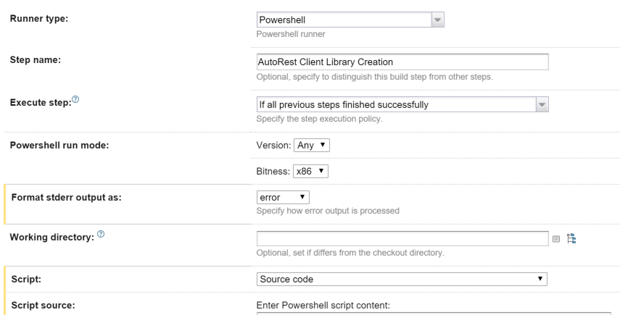
TeamCity Step 2
PowerShell step to run autorest
JSON Input is the dev web server URL
AddCredentials is used to enabled additional code for us to use our basic auth
.\Packages\autorest.0.13.0\tools\AutoRest.exe -OutputDirectory GeneratedCSharp -Namespace MyWebAPI -Input http://MyWebAPI.net/swagger/docs/v1 -AddCredentials
& "C:\Program Files (x86)\MSBuild\14.0\bin\csc.exe" /out:GeneratedCSharp\MyWebAPI.Client.dll /reference:Packages\Newtonsoft.Json.6.0.4\lib\net45\Newtonsoft.Json.dll /reference:Packages\Microsoft.Rest.ClientRuntime.1.8.2\lib\net45\Microsoft.Rest.ClientRuntime.dll /recurse:GeneratedCSharp\*.cs /reference:System.Net.Http.dll /target:library
<frameworkAssemblies>
<frameworkAssembly assemblyName="System.Net.Http" targetFramework="net45" />
</frameworkAssemblies>
<dependencies>
<dependency id="Microsoft.Rest.ClientRuntime" version="1.8.2" />
<dependency id="Newtonsoft.Json" version="6.0.8" />
</dependencies>

Slide 16
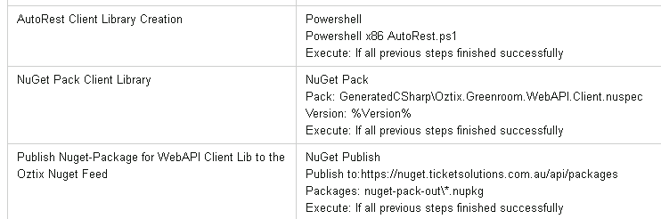
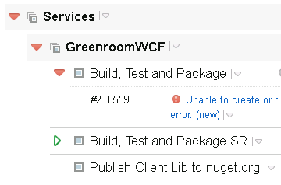
TeamCity Final output
You can then add a nuget pack and publish step to package up the client library and push it
With the project we worked on before we auto pushed to a internal nugget server form CI, then created another build step to run manually to push to nuget.org using an artifact dependency

Slide 17





Other Languages
Examples for a Typescript and JavaScript client library in the build process are available on the blog.
https://beerandserversdontmix.com/2016/01/16/autorest-swagger-codegen-and-swagger/

Slide 18



Questions?
Swagger UI, Swagger Code Gen, Autorest
Joel Dickson
Development Manager at Agoda
https://beerandserversdontmix.com/
www.linkedin.com/in/joel-dickson-hs
https://github.com/dicko2/ _

